Slide 1
Principles of Database Systems (CS307) Lecture 9: Relational Algebra & Query Processing/Optimization
Ran Cheng
Department of Computer Science and Engineering
Southern University of Science and Technology
Most contents are from slides made by Dr Yuxin Ma, Stéphane Faroult and the authors of Database System Concepts (7th Edition).
Their original slides have been modified to adapt to the schedule of CS307 at SUSTech.
Notes:
In this chapter, I will introduce how to retrieve data from one table. Just from one table. I will introduce how to retrieve data from multiple table in next chapter.

Slide 2
Relational Algebra

Slide 3
Relational Algebra
A procedural language consisting of a set of operations that take one or more relations as input and produce a new relation as their result.
6 Basic Operators:
select: σ
project: ∏
union: ∪
set difference: –
Cartesian product: x
rename: ρ

Slide 4
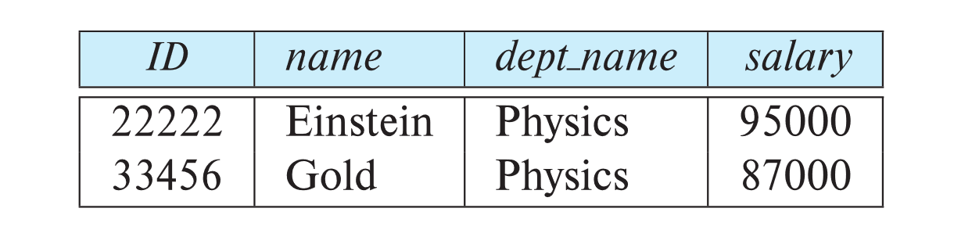
Select Operation
The select operation selects tuples that satisfy a given predicate (谓词：用来代替或者展示其客体性质、特征或者客体之间关系的词项)
Notation: σ _{p} (r)
p is called the selection predicate
r is a relation
Example
Select those tuples of the instructor relation where the instructor is in the “Physics” department
σ _{dept_name = “Physics”} (instructor)

Slide 5
Select Operation
We allow comparisons using =, ≠, >, ≥, <, ≤ in the selection predicate
We can combine several predicates into a larger predicate by using the connectives:
∧ (and), ∨ (or), ¬ (not)
Example: Find the instructors in Physics with a salary greater $90,000, we write:
σ dept_name = “Physics”∧ salary > _{90,000} (instructor)
The select predicate may include comparisons between two attributes.
Example, find all departments whose name is the same as their building name:
σ _{dept_name=building} (department)

Slide 6
Project Operation
A unary operation that returns its argument relation, with certain attributes left out.
Notation: ∏ _{A1,A2,A3 ….Ak} (r)
where A₁, A₂, …, A_{k} are attribute names and r is a relation name.
The result is defined as the relation of k columns obtained by erasing the columns that are not listed
Duplicate rows removed from result, since relations are sets

Slide 7
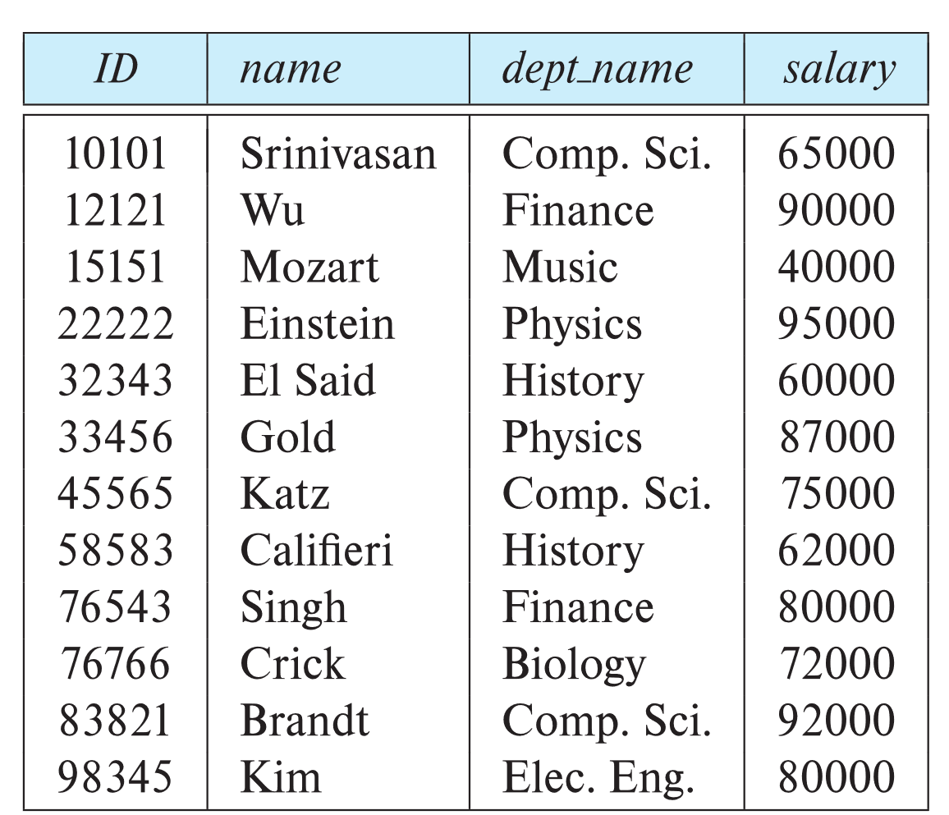
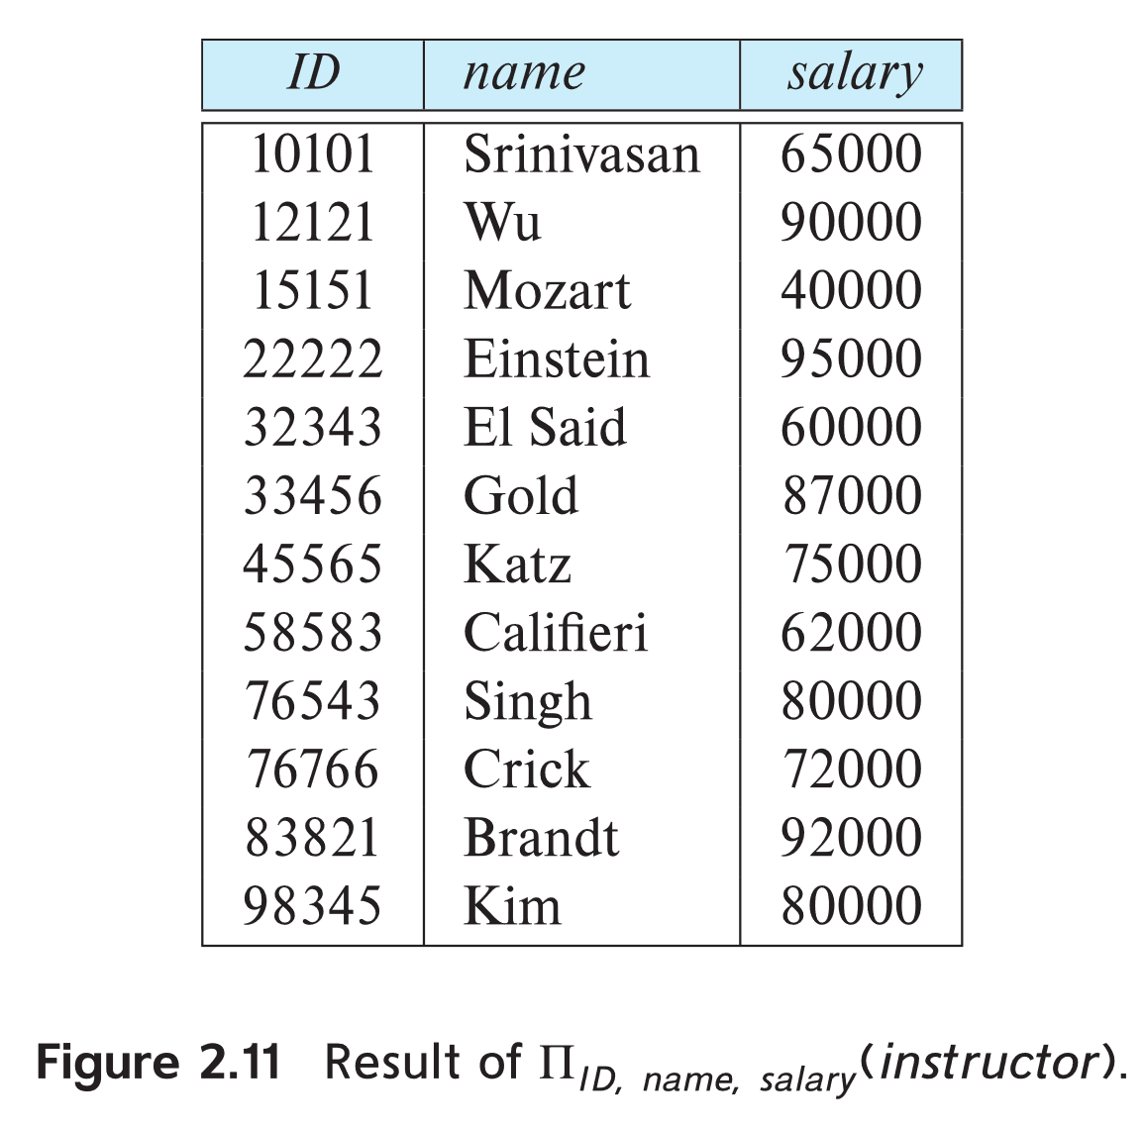
Project Operation
Example: eliminate the dept_name attribute of instructor
Query:
∏_{ID, name, salary} (instructor)

Slide 8
Composition of Relational Operations
The result of a relational-algebra operation is relation
… and therefore, relational-algebra operations can be composed together into a relational-algebra expression
Consider the query: Find the names of all instructors in the Physics department
∏_{name}(σ _{dept_name} _{= “Physics”} (instructor))
Instead of giving the name of a relation as the argument of the projection operation, we give an expression that evaluates to a relation
How about in SQL expression?

Slide 9
Cartesian-Product Operation
A×B={(x,y)|x∈A∧y∈B}
The Cartesian-product operation (denoted by ×) allows us to combine information from any two relations.
Example: the Cartesian product of the relations instructor and teaches is written as:
instructor × teaches
We construct a tuple of the result out of each possible pair of tuples
… one from the instructor relation and one from the teaches relation (see next slide)
Since the instructor ID appears in both relations we distinguish between these attribute by attaching to the attribute the name of the relation from which the attribute originally came.
instructor.ID
teaches.ID

Slide 10
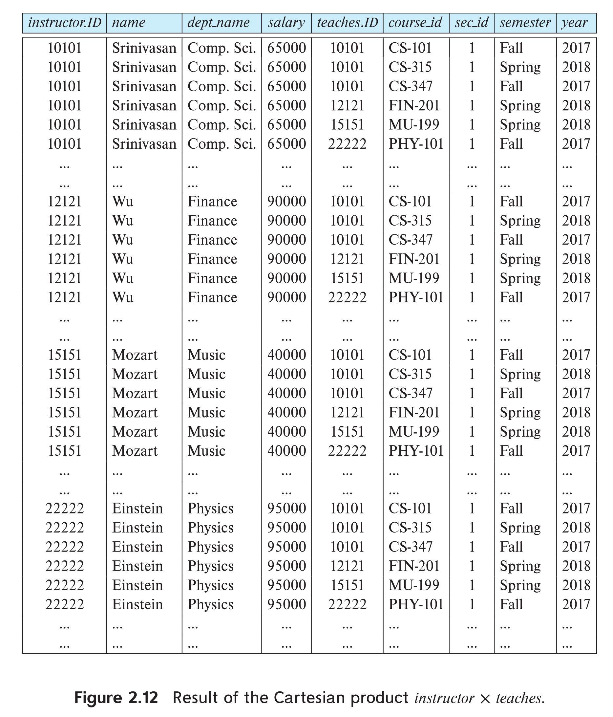
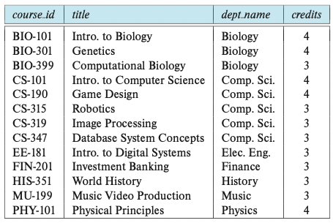
The “instructor × teaches” table

Slide 11
Join Operation
Problem: The Cartesian-Product “instructor × teaches” associates every tuple of instructor with every tuple of teaches
Most of the resulting rows have information about instructors who did NOT teach a particular course

Slide 12
Join Operation
To get only those tuples of “instructor × teaches” that pertain to instructors and the courses that they taught, we write:
σ _{instructor.id = teaches.id} (instructor × teaches)
We get only those tuples of “instructor × teaches” that pertain (关于) to instructors and the courses that they taught
i.e., those tuples where instructor.id = teaches.id

Slide 13
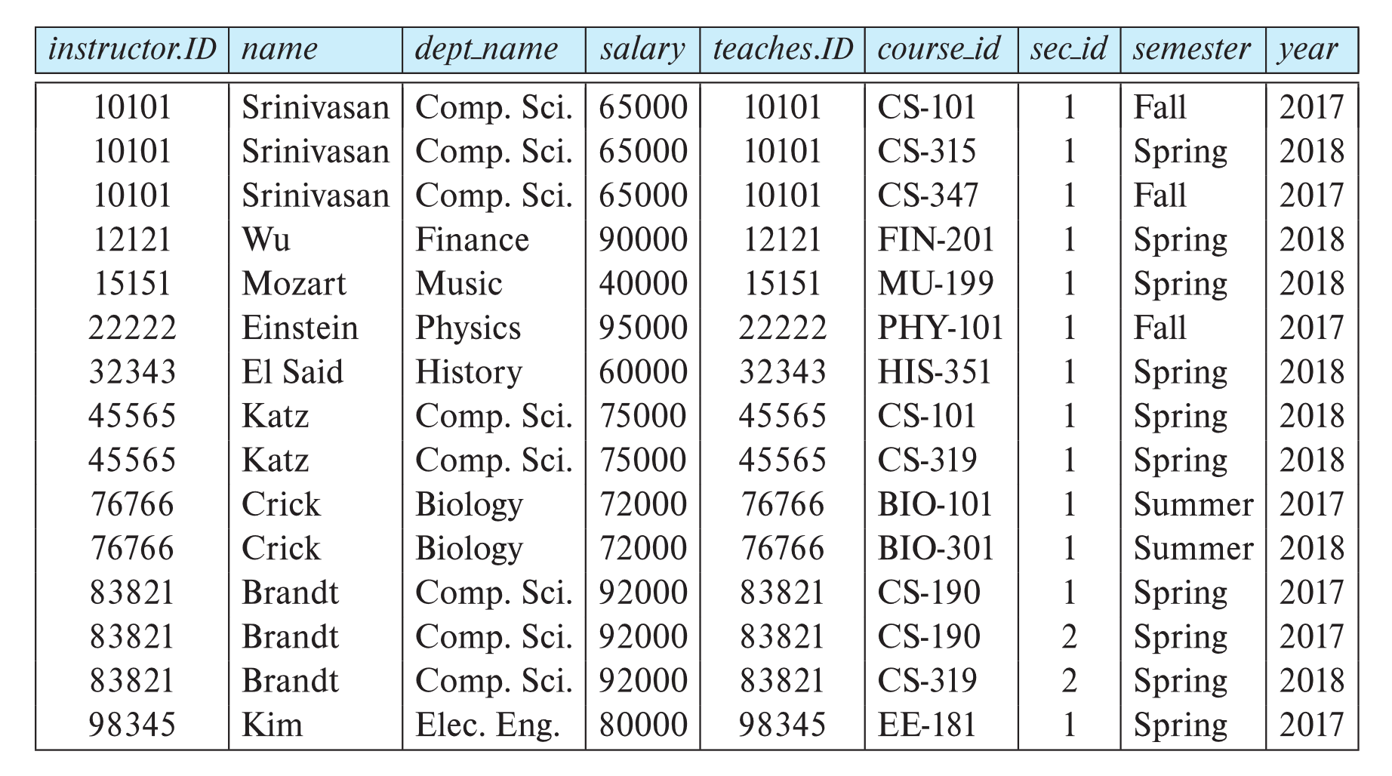
Join Operation
The table corresponding to σ _{instructor.id = teaches.id} (instructor × teaches):

Slide 14

Join Operation
The table corresponding to σ _{instructor.id = teaches.id} (instructor × teaches):
… will NOT include such tuples (rows) with different IDs

Slide 15
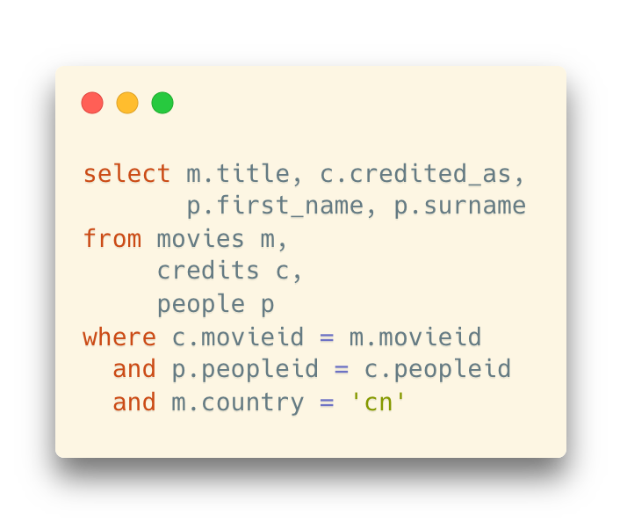
Recall: The Old Way of Writing Joins
Use commas to separate the tables
Example: The solution for the same question in the previous slide
A little bit history:
join was introduced in SQL-1999 (later than this original way)
The SQL syntax was derived from the form of cartesian products in relational algreba
σ movies.id = credits.id ∧ people.peopleid = credits.peopleid ∧ movies.country = “cn” (Movies × Credits × People)

Slide 16
Recall: The Old Way of Writing Joins
Use commas to separate the tables
Example: The solution for the same question in the previous slide
A little bit history:
join was introduced in SQL-1999 (later than this original way)
Use commas as the “multiplication signs”
The “select operation” is written as the “where” clause here
The SQL syntax was derived from the form of cartesian products in relational algreba
σ movies.id = credits.id ∧ people.peopleid = credits.peopleid ∧ movies.country = “cn” (Movies × Credits × People)

Slide 17
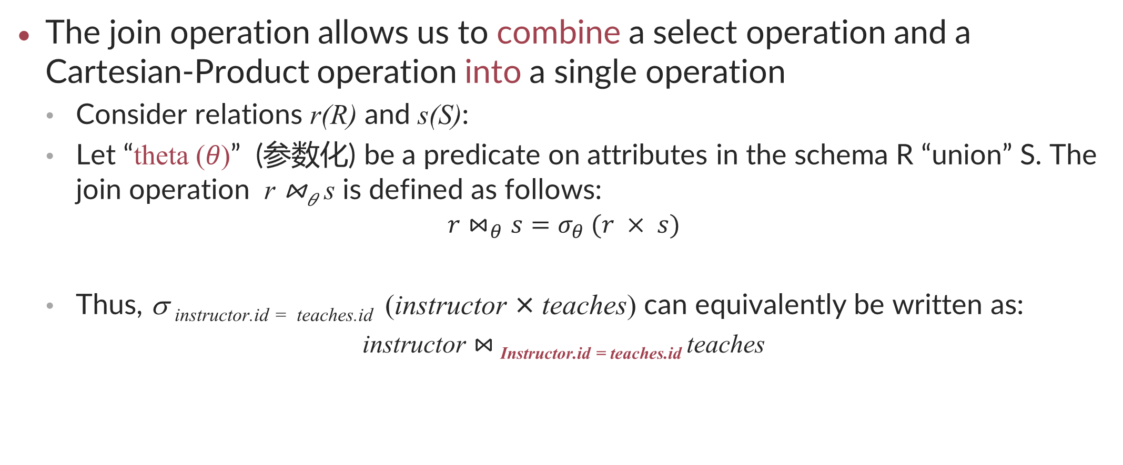
Join Operation
The join operation allows us to combine a select operation and a Cartesian-Product operation into a single operation
Consider relations r(R) and s(S):
Let “theta (𝜃)” (参数化) be a predicate on attributes in the schema R “union” S. The join operation r ⋈_{𝜃} s is defined as follows:
$$r⋈_{θ}s=σ_{θ} (r × s)$$
Thus, σ _{instructor.id = teaches.id} (instructor × teaches) can equivalently be written as:
instructor $⋈_{ }$_{Instructor.id = teaches.id} teaches

Slide 18
Union Operation
The union operation allows us to combine two relations
Notation: r ∪ s
For r ∪ s to be valid:
r, s must have the same arity (same number of attributes)
The attribute domains must be compatible
Example: 2nd column of r deals with the same type of values as does the 2nd column of s

Slide 19
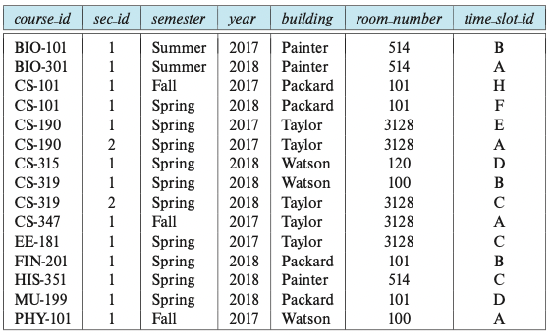
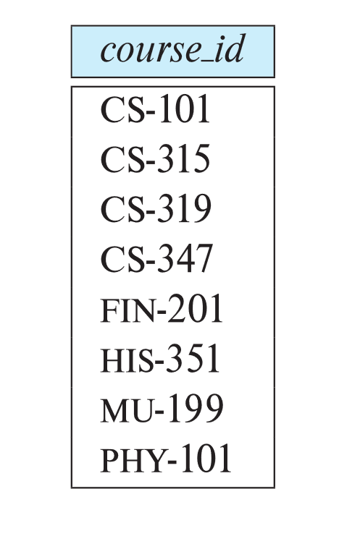
Union Operation
Example: To find all courses taught in the Fall 2017 semester, or in the Spring 2018 semester, or in both
∏_{course_id} (σ _{semester=“Fall” Λ year=2017} (section)) ∪ ∏_{course_id} (σ _{semester=“Spring” Λ year=2018} (section))
section

Slide 20
Set-Intersection Operation
The set-intersection operation allows us to find tuples that are in both the input relations
Notation: r ∩ s
Assume (same as Union):
r, s have the same arity
Attributes of r and s are compatible

Slide 21
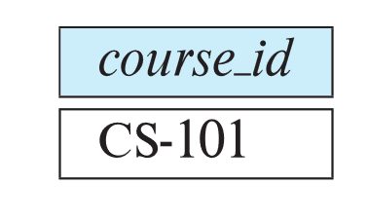
Set-Intersection Operation
Example: Find the set of all courses taught in both the Fall 2017 and the Spring 2018 semesters
∏_{course_id} (σ _{semester=“Fall” Λ year=2017} (section)) ∩ ∏_{course_id} (σ _{semester=“Spring” Λ year=2018} (section))
section

Slide 22
Set Difference Operation
The set-difference operation allows us to find tuples that are in one relation but are not in another
Notation: r – s
Assume (same as Union and Set Intersection):
r, s have the same arity
Attributes of r and s are compatible

Slide 23

Set Difference Operation
Example: Find all courses taught in the Fall 2017 semester, but NOT in the Spring 2018 semester
∏_{course_id} (σ _{semester=“Fall” Λ year=2017} (section)) – ∏_{course_id} (σ _{semester=“Spring” Λ year=2018} (section))
section

Slide 24
The Assignment Operation
It is convenient at times to write a relational-algebra expression by assigning parts of it to temporary relation variables
The assignment operation is denoted by ← and works like assignment in a programming language
Example: Find all instructor in the “Physics” and Music department
Physics ← σ _{dept_name = “Physics”} (instructor)
Music ← σ _{dept_name = “Music”} (instructor)
Physics ∪ Music
With the assignment operation, a query can be written as a sequential program consisting of a series of assignments followed by an expression whose value is displayed as the result of the query.

Slide 25
The Rename Operation
The results of relational-algebra expressions do not have a name that we can use to refer to them
The rename operator, ρ, is provided for that purpose
The expression ρ_{x} (E) returns the result of expression E under the name x
Another form of the rename operation which also renames the columns:
ρ_{x(A1,A2, .. An)} (E)

Slide 26
Equivalent Queries
There is more than one way to write a query in relational algebra
Example: Find information about courses taught by instructors in the Physics department with salary greater than 90,000
Query 1
σ dept_name = “Physics” ∧ salary > 90,000 (instructor)
Query 2
σ _{dept_name = “Physics”} (σ _{salary > 90.000} (instructor))
The two queries are not identical
they are, however, equivalent -- they give the same result on any database

Slide 27
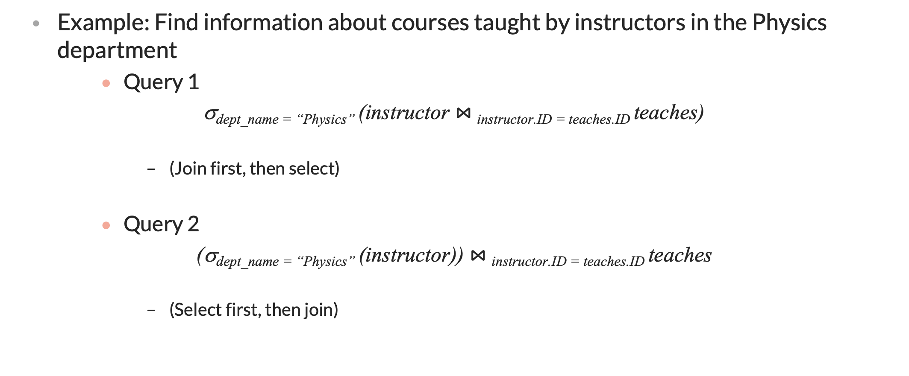
Equivalent Queries
Example: Find information about courses taught by instructors in the Physics department
Query 1
σ_{dept_name = “Physics”} (instructor $⋈_{ }$_{instructor.ID = teaches.ID} teaches)
(Join first, then select)
Query 2
(σ_{dept_name = “Physics”} (instructor)) $⋈_{ }$_{instructor.ID = teaches.ID} teaches
(Select first, then join)

Slide 28
Equivalent Queries
Application of Relational Algebra: Query Optimization
Transform queries into equivalent ones with less computational cost

Slide 29
Query Processing

Slide 30
Basic Steps in Query Processing
Parsing and translation: translate the query into its internal form, and then into relational algebra.
Evaluation: the query-execution engine takes a query-evaluation plan, executes that plan, and returns the answers to the query.

Slide 31
Basic Steps in Query Processing
A relational algebra expression may have many equivalent expressions
E.g., σ_{salary<75000}(∏_{salary}(instructor)) is equivalent to ∏_{salary}(σ_{salary<75000}(instructor))
Each relational algebra operation can be evaluated using one of several different algorithms
Correspondingly, a relational-algebra expression can be evaluated in many ways.
Annotated expression specifying detailed evaluation strategy is called an evaluation-plan. e.g.,:
Use an index on salary to find instructors with salary < 75000,
or
Perform complete relation scan and discard instructors with salary ≥ 75000

Slide 32
Query Optimization
Query Optimization: Amongst all equivalent evaluation plans choose the one with lowest cost.
Cost is estimated using statistical information from the database catalog
e.g.. number of tuples in each relation, size of tuples, etc.
We will study:
How to measure query costs
Algorithms for evaluating relational algebra operations
How to combine algorithms for individual operations in order to evaluate a complete expression

Slide 33
Measure of Query Cost
Many factors contribute to time cost
disk access, CPU, and network communication
Cost can be measured based on
response time (latency), i.e. total elapsed time for answering query, or
total resource consumption
We use total resource consumption as cost metric
Response time harder to estimate, and minimizing resource consumption is a good idea in a shared database
We ignore CPU costs for simplicity
Real systems do take CPU cost into account
Network costs must be considered for parallel systems
Main cost is from the hard-disk

Slide 34
Measure of Query Cost
Disk cost can be estimated as:
Number of seeks * average-seek-cost
Number of blocks read * average-block-read-cost
Number of blocks written * average-block-write-cost
Let’s take selection operation as an example

Slide 35
Measure of Query Cost
For simplicity we just use the number of block transfers （read/write） from disk and the number of seeks as the cost measures
t_{T} – time to transfer one block
Assuming for simplicity that write cost is same as read cost
t_{S} – time for one seek
Cost for b block transfers plus S seeks b * t_{T} + S * t_{S}
t_{S} and t_{T} depend on where data is stored; with 4 KB blocks:
High end magnetic disk: t_{S} = 4 msec and t_{T} =0.1 msec
SSD: t_{S} = 20-90 microsec and t_{T} = 2-10 microsec for 4KB
Let’s take selection operation as an example

Slide 36
Example: Selection Operation
File scan
Algorithm: Linear Search. Scan each file block and test all records to see whether they satisfy the selection condition.
Cost estimate = b_{r} block transfers + 1 seek
b_{r} denotes number of blocks containing records from relation r
Linear search can be applied regardless of
selection condition or
ordering of records in the file, or
availability of indices
Note: binary search generally does NOT make sense since data is not stored consecutively
except when there is an index available and binary search requires more seeks than index search

Slide 37
Example: Selection Operation
Faster ways?
Index scan – search algorithms that use an index
Selection condition must be on search-key of index
We may build an index on the relation, and then use the index to read the relation in sorted order.
For relations that fit in memory, techniques like quicksort can be used.
For relations that do NOT fit in memory, external merge-sort is a good choice. Why?

Slide 38
Example: Selection Operation Merge-Sort
All intermediate results can be stored in the buffer space
Disk is cheap for the additional buffer space
Slower, but scalable – batch

Slide 39
Example: Selection Operation Merge-Sort
Let M denote batch size (in blocks).
1. Create sorted runs. Let i be 0 initially. Repeatedly do the following till the end of the relation: (a) Read M blocks of relation into memory (b) Sort the in-memory blocks (c) Write sorted data to run R_{i}; increment i.
Let the final value of i be N
2. Merge the runs – How?

Slide 40
Query Optimization

Slide 41
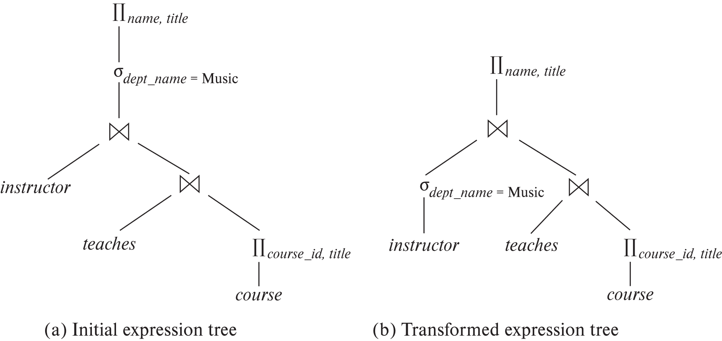
Evaluating a given query
Alternative ways of evaluating a given query
Equivalent expressions
Different algorithms for each operation
One expression -> multiple ways to evaluate

Slide 42
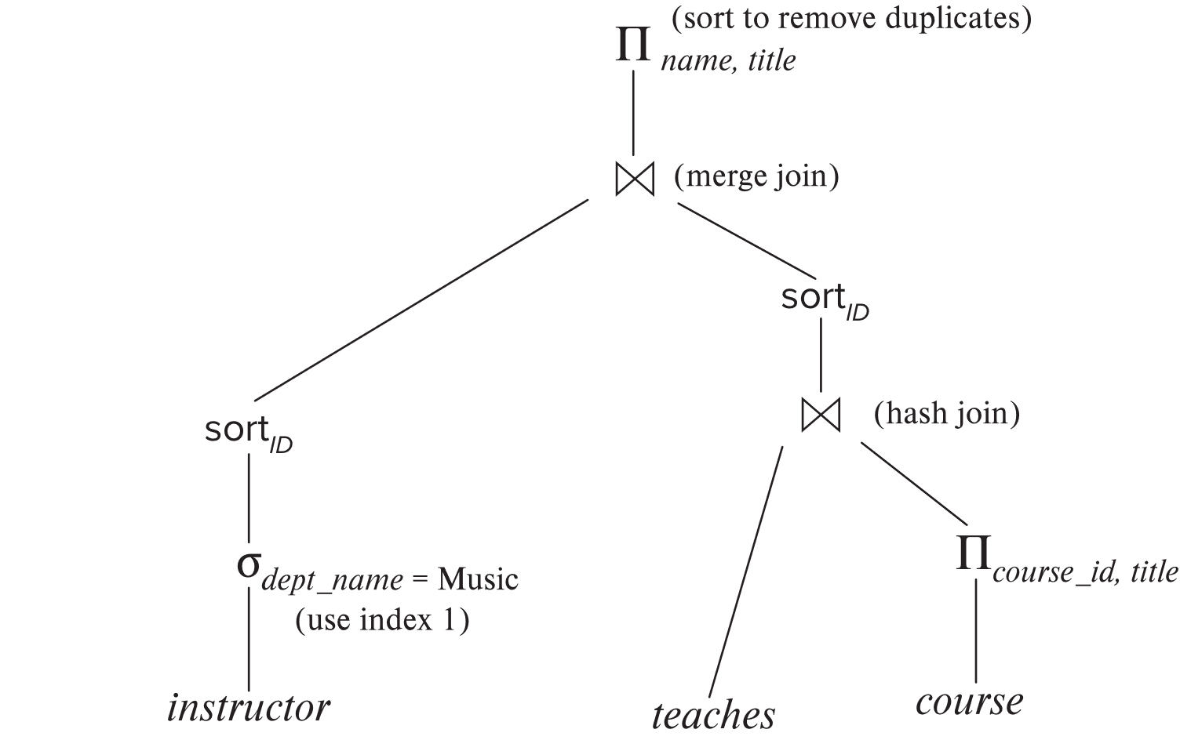
Evaluation plan
An evaluation plan defines exactly what algorithm is used for each operation, and how the execution of the operations is coordinated.

Slide 43
Query optimization via evaluation plans
Cost difference between evaluation plans for a query can be enormous
e.g., seconds vs. days in some cases
Steps in cost-based query optimization
1. Generate logically equivalent expressions using equivalence rules
2. Annotate resultant expressions to get alternative evaluation plans
3. Choose the cheapest plan based on estimated cost
Estimation of plan cost based on:
Statistical information about relations, e.g.:
number of tuples, number of distinct values for an attribute
Statistics estimation for intermediate results
to compute cost of complex expressions
…
Result of optimization – Query plan:
Postgre -- EXPLAIN

Slide 44
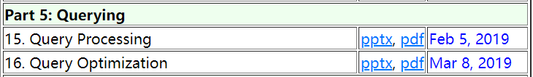
More to read
https://db-book.com/slides-dir/index.html

